Slide 1
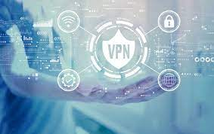
Creating A Ticket to Establish a VPN Connection to work from home

Slide 2
What is a VPN?
A Virtual Private Network
What are the benefits?
Security
Anonymity

Slide 3
Prerequisites
VPN Service Information
Your credentials
Guide for setting up a VPN

Slide 4
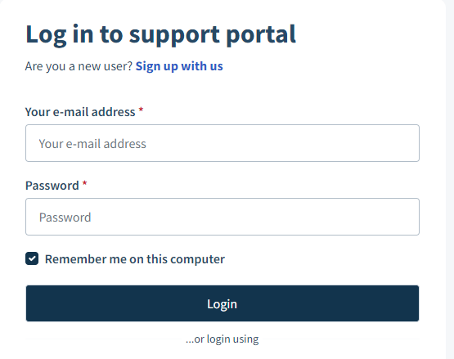
Step 1: Login to Freshdesk

Slide 5
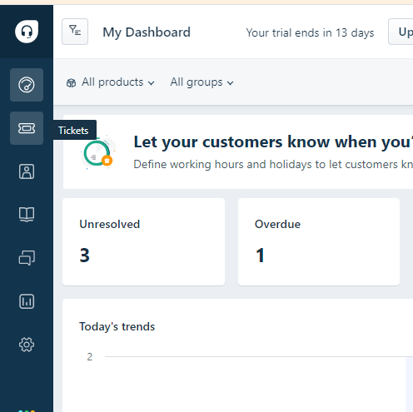
Step 2: Navigate to Tickets

Slide 6
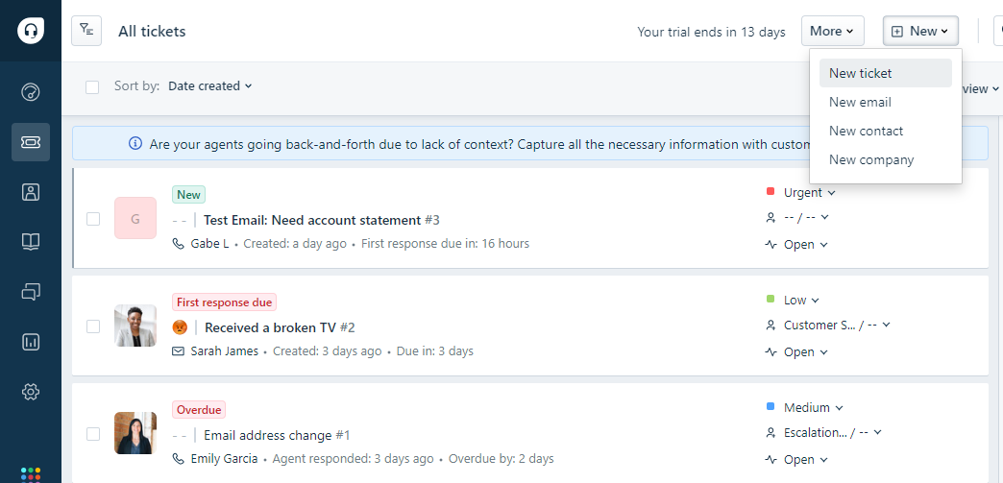
Step 3: Create a New Ticket

Slide 7
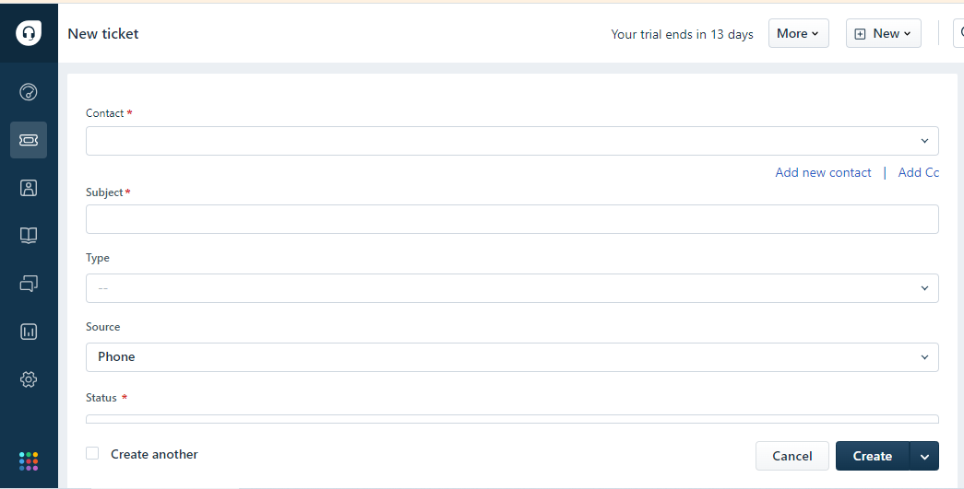
Step 4: Enter Ticket Details

Slide 8
Step 4: Enter Ticket Details
Subject
Description
Priority
Category

Slide 9
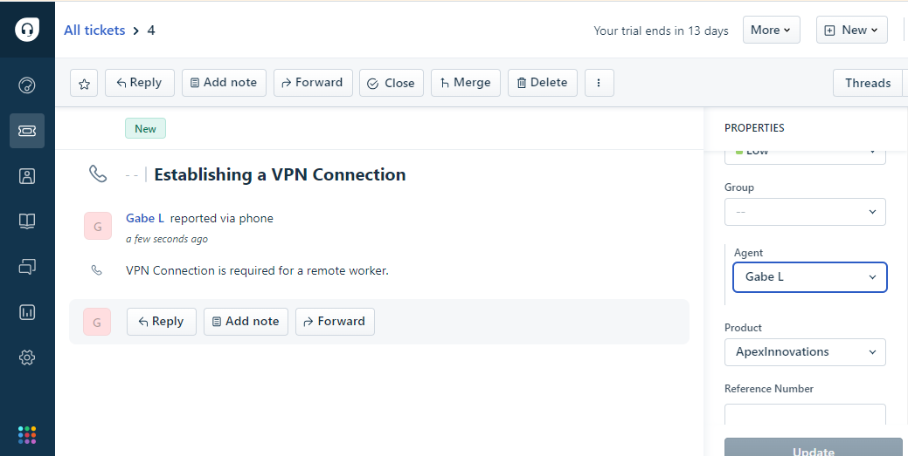
Step 5: Assign Agent

Slide 10
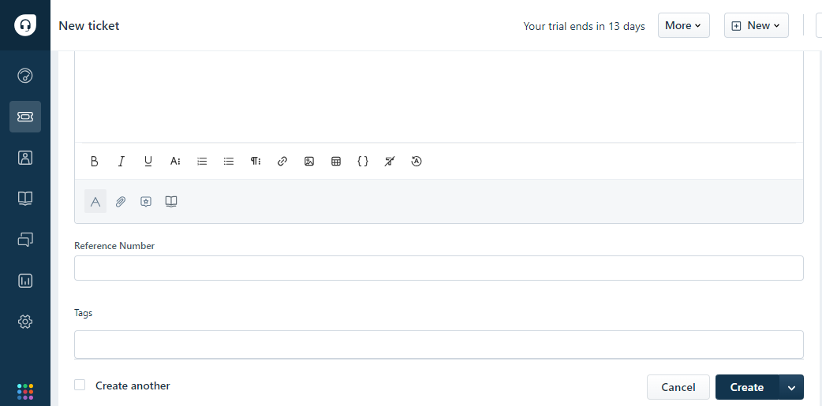
Step 6: Submit Ticket

Slide 11
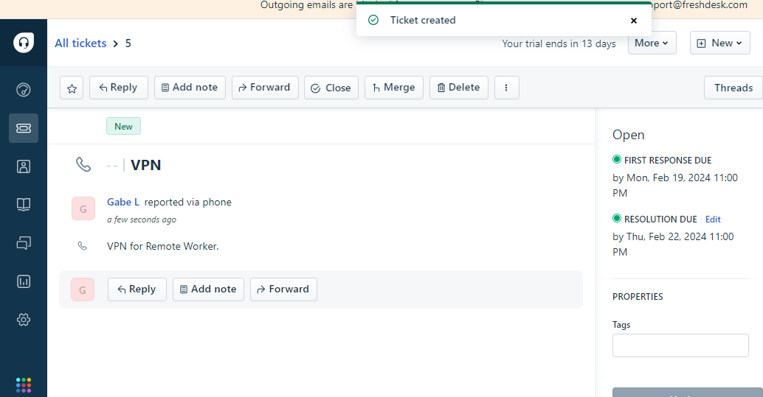
Step 7: Confirmation and Tracking

Slide 12

Step 8: Agent Follow-Up

Slide 13
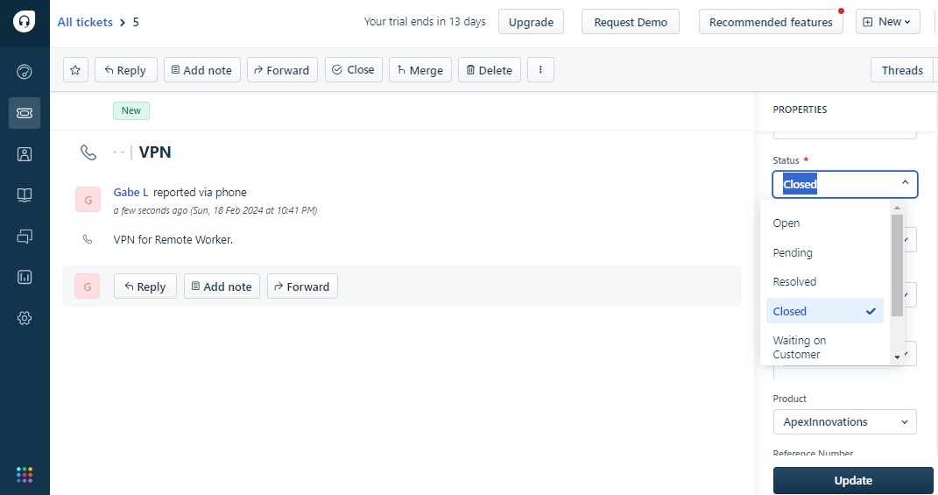
Step 9: Resolution and Closure

Slide 14
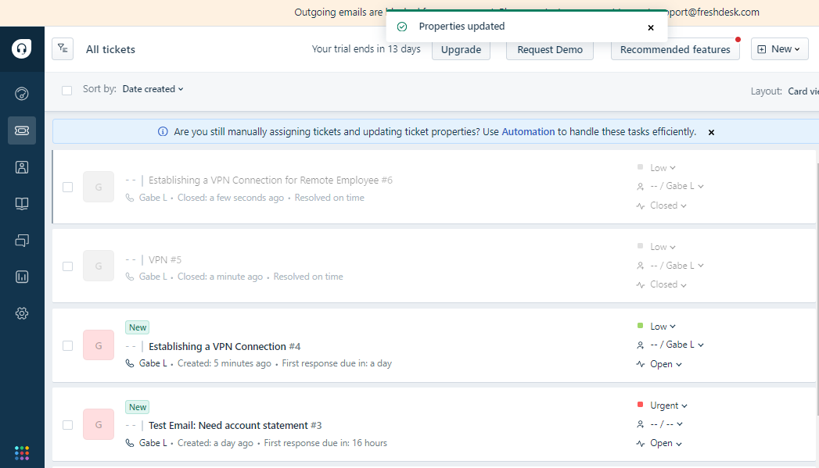
Step 9: Resolution and Closure

